Slide 1
4 C
SHORT LIFE, LONG LIFE

Slide 2

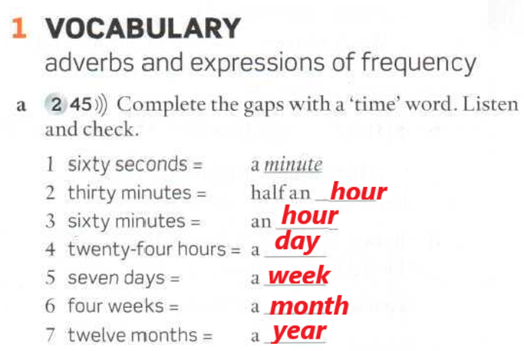

Slide 3
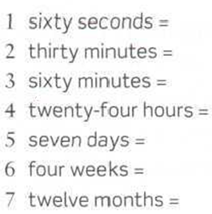
A minute
Half an hour
An hour
A day
A week
A month
A year

Slide 4
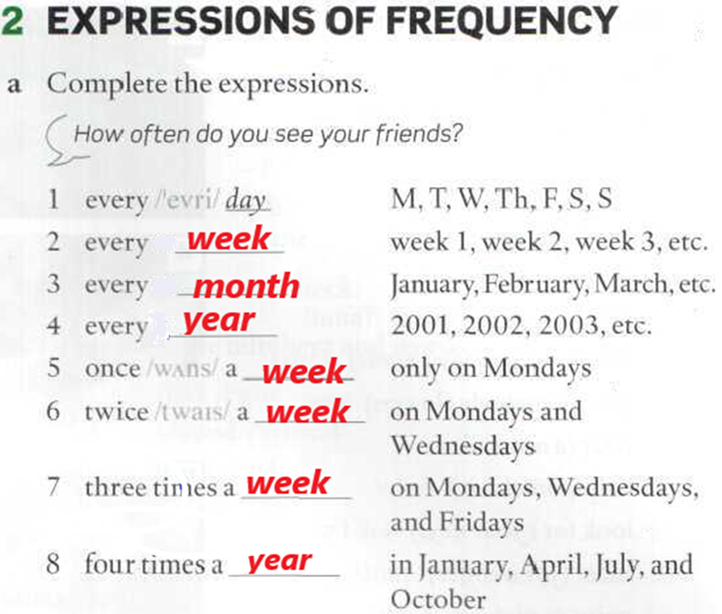
How often do you see your friends?

Slide 5
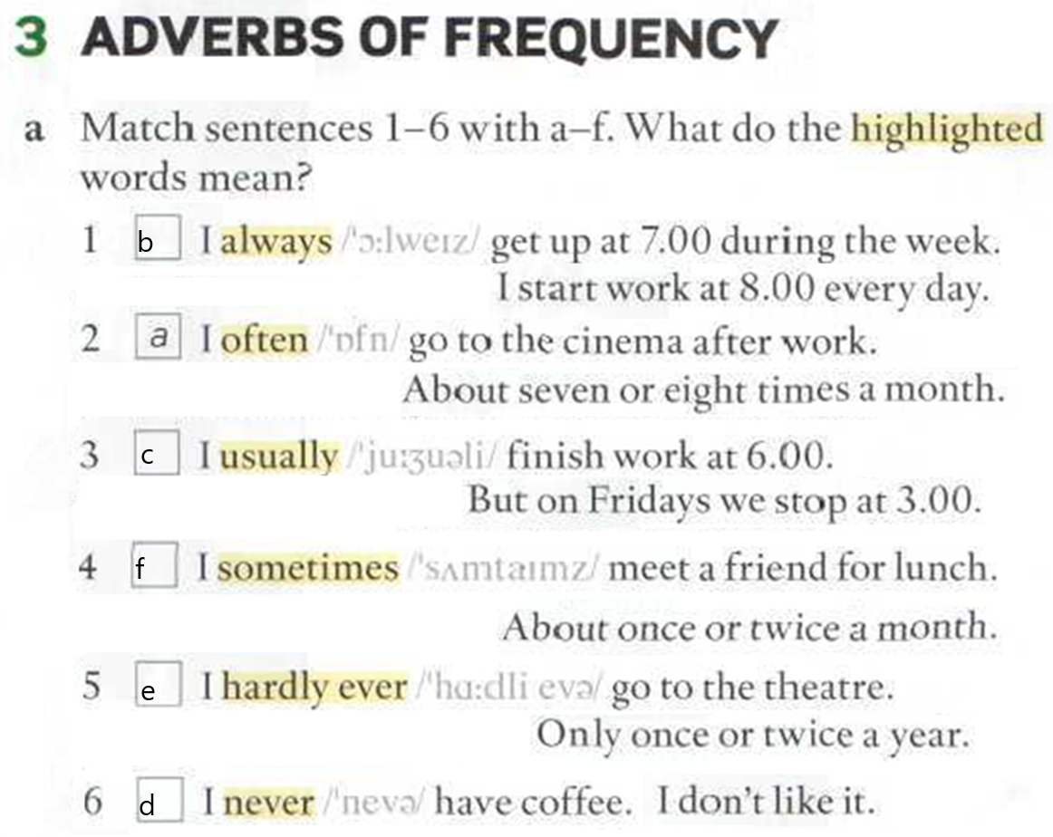
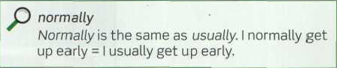
Memorize the adverbs of frequency

Slide 6
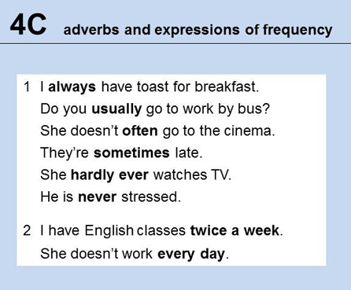
Sometimes and Usually can be used at the beginning of a clause or sentences for emphasis.
Sometimes I get up early.

Slide 7
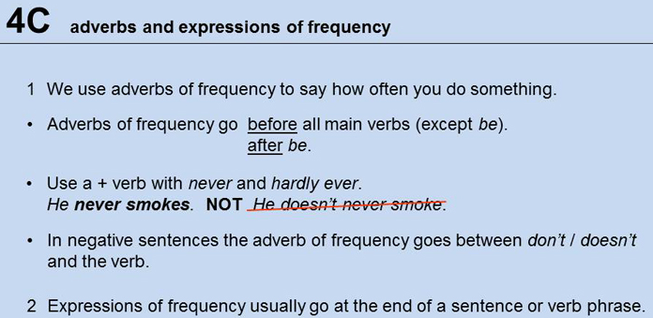

Slide 8
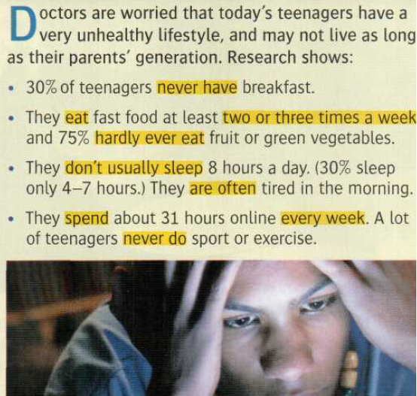





Slide 9
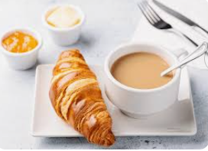
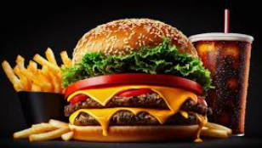
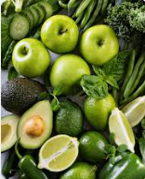
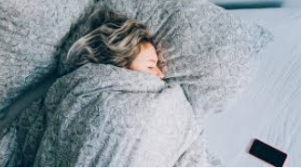
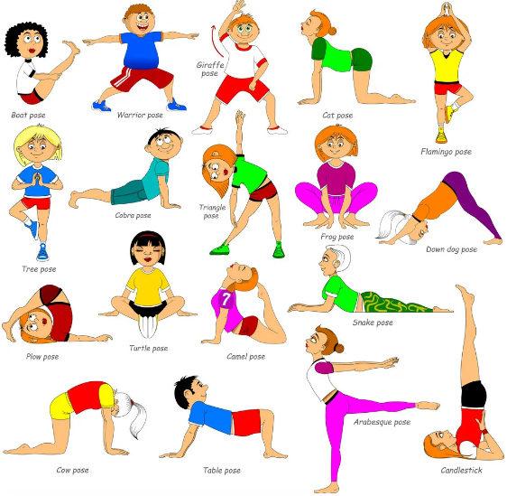
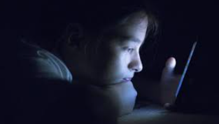
Make sentences about the article. Make true sentences about you.
BREAKFAST
FASTFOOD
FRUIT OR GREEN VEGETABLES
SLEEP
ONLINE
SPORT OR EXERCISE

Slide 10
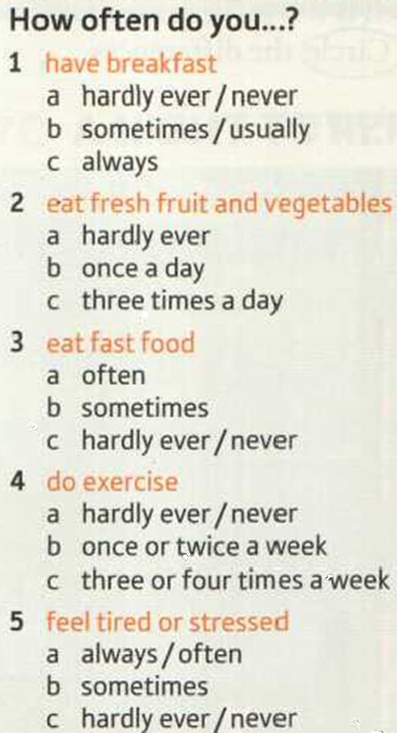
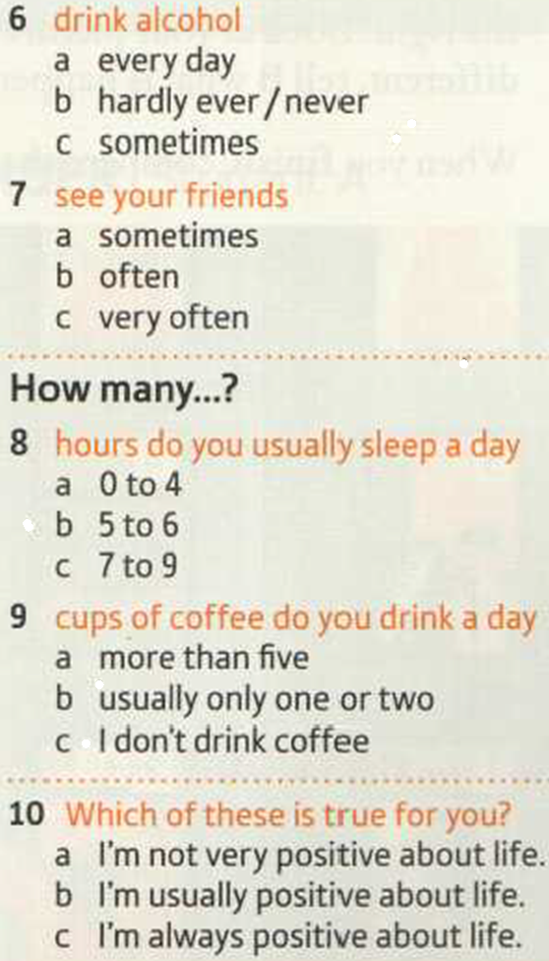

Communication 101

Slide 11
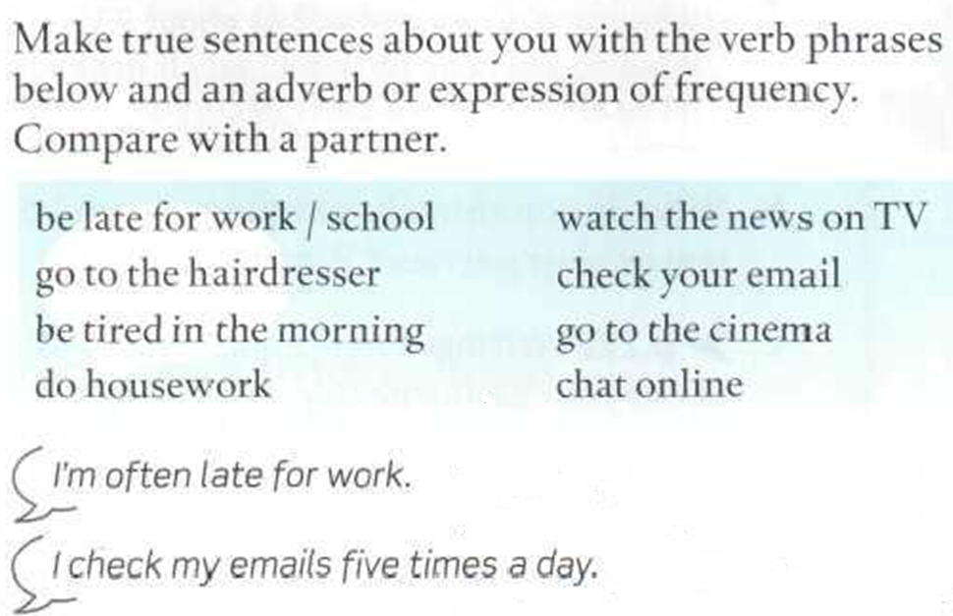
Conversation practice

Slide 12
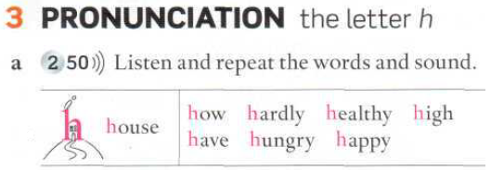
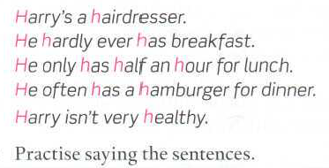
Pronunciation practice

Slide 13
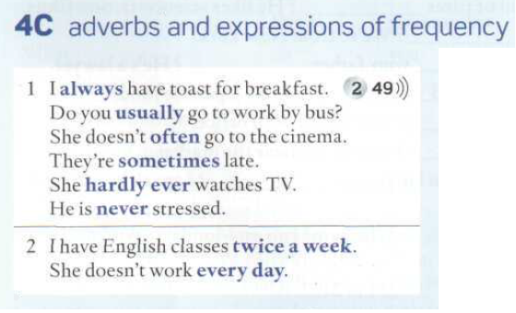
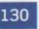
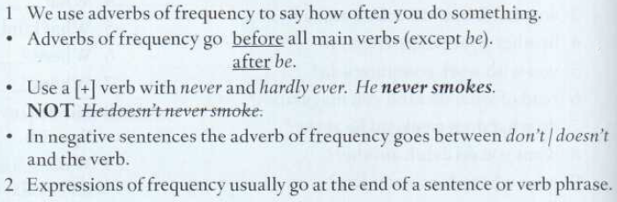

Slide 14

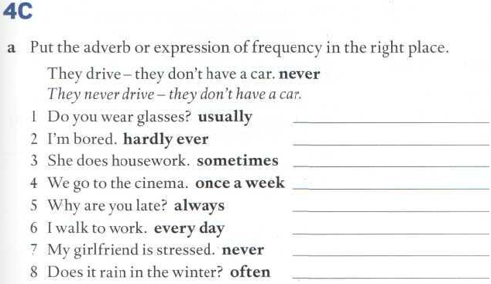
Do you usually wear glasses?
I’m hardly ever bored.
She sometimes does housework.
I go to the cinema once a week.
Why are you always late?
I walk to work every day.
My girlfriend is never stressed.
Does it often rain in the winter?

Slide 15
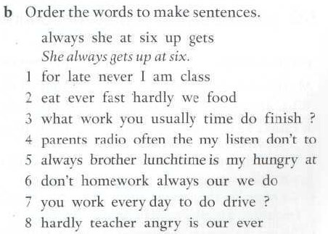
Page 131
She always gets up at six.
I am never late for class.
We hardly ever eat fast food.
What time do you usually finish work?
My parents don’t often listen to the radio.
My brother is always hungry at lunchtime.
We don’t always do our homework.
Do you drive to work every day?
Our teacher is hardly ever angry.

Slide 16

Can you understand these people?
ANSWER THE QUESTIONS.
WRITE THE QUESTIONS.
3&4 Revise and Check - page 34

Slide 17
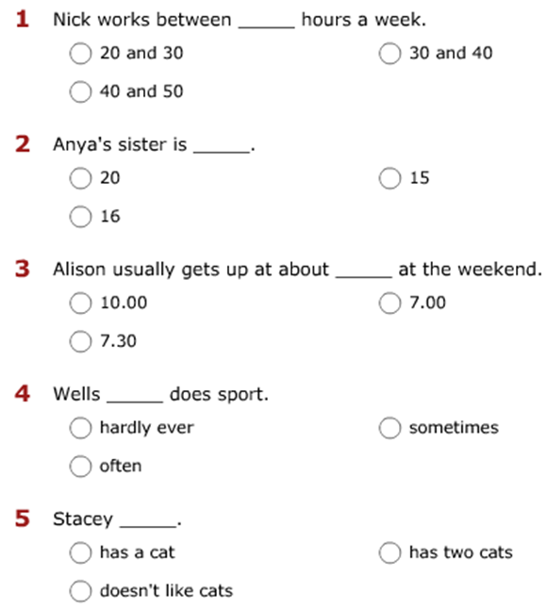

Slide 18

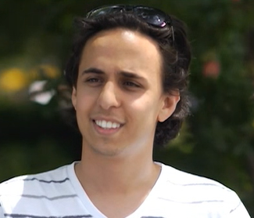

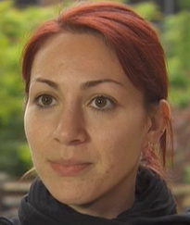

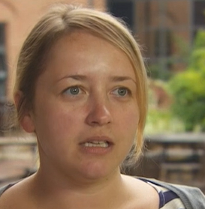

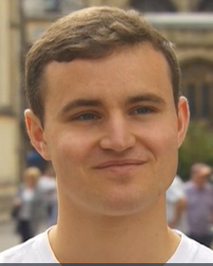

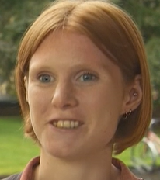
I = interviewer, N = Nick
I What do you do?
N I'm a gardener.
I How many hours a week do you work?
N About 20, 30 hours a week. It’s an easy job.
I = interviewer, A = Anya
I Do you have a big family?
A I have. There are five people in my family. I have one brother and one sister, and my parents.
I How old are your brother and sister?
A My brother is 20 and my sister is 16.
I = interviewer, Al = Alison
I What time do you get up in the morning?
A I usually get up at about seven o'clock in the morning.
I What about at weekends?
A At the weekend it’s a bit later. I usually get up at about ten o'clock.
I = interviewer, W = Wells
I How often do you do sport or exercise?
W Almost every day.
I What do you do?
W I run. And play football.
I = interviewer, S = Stacey
I Do you like animals?
S Yes, I love animals.
I Do you have a pet?
S I do. I have a cat.

